Slide 1
OMS Log Analytics Labs Intro
Trainer

Slide 2
Operations Management Suite

Slide 3



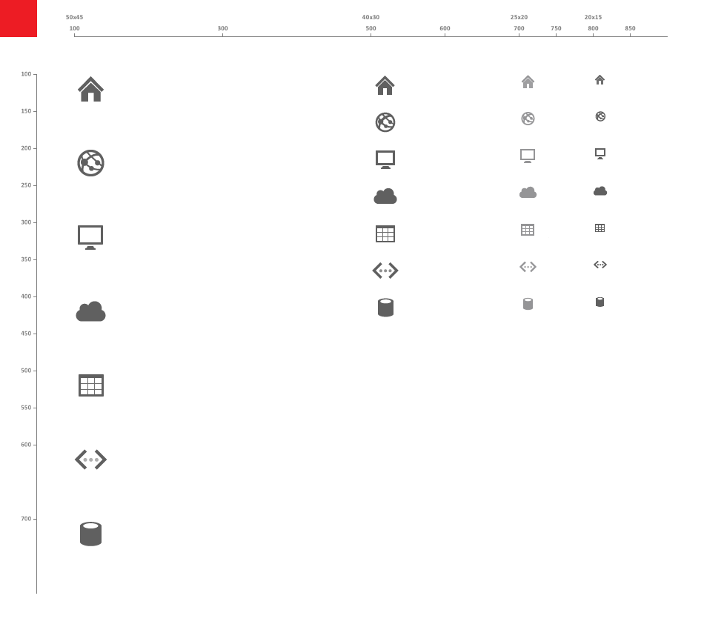
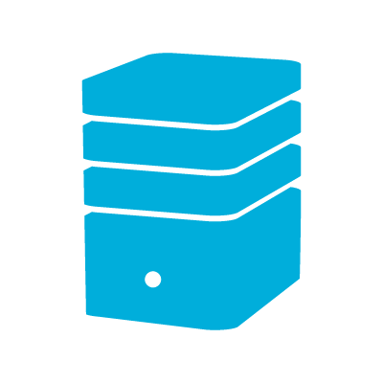










Operation Management Suite
Google
AWS
Log Analytics
Search, Correlate & Combine
Visualize Results
Centralized & Extensible Collection
Multiple Data Sources regardless of Volume, Format or Location
Ready Made Intelligence
Forecast Capacity
Assess System Update, Malware, Configuration
Change Tracking
Respond to Threats
Identify security breaches
Audit & Compliance
Azure VMs
Azure
Storage Diagnostics
Azure PaaS
Log Analytics Solutions:
Updates
Automation
Disaster recovery
Backup
WireData
Security & Audit
AD health
Service Map
3rd Party API
Search & Analytics
Microsoft Azure Log Analytics
Cloud
Azure Storage
Portal
Servers forwarding data through SCOM
Servers directly forwarding data
Windows & Linux Server
Windows & Linux Server
0365|AAD|SP|Exchange*
AVAILABILITY
REAL TIME
SEARCH
READY MADE INTELLIGENCE
DASHBOARDS
& REPORTING
SCALABLE
Automation
SECURITY
Notes:
Microsoft Operations Management Suite (OMS) is the all-in-one hybrid cloud management solution for any enterprise to manage their workloads and applications on Azure or AWS, Windows Server or Linux, VMware or OpenStack in the most cost-effective way.
The principle of OMS is collecting all the system data and perform intelligence on that.
Public Cloud offers this possibility. Huge amounts of data storage, fast searching and enormous scale. You can’t do this in your own data center.
Detect anomalies
Data entering OMS trough the OMS client is unstructured and being indexed on arrival.
This allows really fast search and supports various data formats.
If we look at traditional monitoring it’s depended of infrastructure of database and high-end storage. Therefor principle is to select which alert you want to receive and which ones not. It takes time to tune.
If not you will receive too many alerts but then you will miss crucial patterns.
Although traditional monitoring provides us a form of proactive operations it does not provide deep insights and troubleshooting is still a manual time consuming process.
With the cloud cadence companies miss the ability to manage multiple environments & platforms.

Slide 4


Operations Management Suite Capabilities
Log analytics
Backup & Recovery
IT Automation
Security & Compliance
Effortless log collection
Integrated fast search and queries with custom dashboard
Integrated cloud backup
Seamless disaster recovery and workload migration
Hybrid runbook worker
Graphical workbook authoring and automation DSC
Malware assessment
Security posture and system update assessment
With OMS capabilities customers can…
Spot problems fast
Protect data easily
Automate tasks quick
Recognize threat early
extending System Center capabilities, as an all-in-one management solution!
Notes:
The foundation of OMS is 2 services, 1 log analytics (formerly known as operational insights) and the other one automation.
If you want to manage an environment you need the ability get insight and visibility of what’s going on. With that insight you can make decisions. And with decisions you want to take action. And that’s where automation comes in.
So see, act, manage

Slide 5
System Center Advisor
Operational Insights
[OMS] Log analytics

Slide 6
Log Analytics

Slide 7
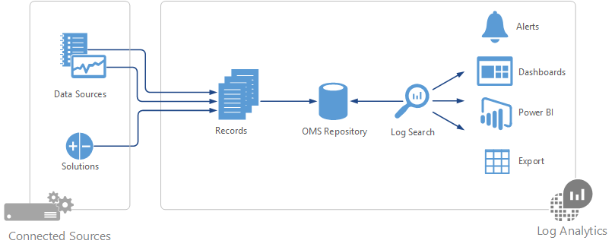
How does OMS Log Analytics work?

Slide 8





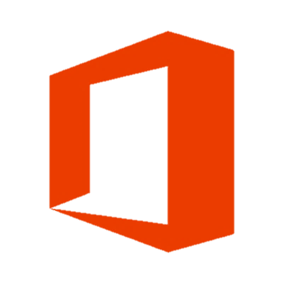

Collect any machine data
Operations Manager
Windows agents
Linux / FluentD
Search & Analytics
HTTP Data Collector API
Solutions
Azure Portal
…sample list of log/metrics that OMS collects:
Custom Application/Infra logs
Azure Platform telemetry
Windows event logs
Window performance counters
Security Event Logs
IIS Logs
ETW logs
Zabbix/Nagios
Azure Metrics, Diagnostic Log, Activity Log
Linux Syslog
Linux system metrics
Firewall Logs
Networking Syslog
JSON doc
O365 Activity Events
Log Stash
SaaS services
O365
AppInsights

Slide 9
Data Sources
Data Source | Event Type | Description
Custom logs | <LogName>_CL | Text files on Windows or Linux agents containing log information.
Windows Event logs | Event | Events collected from the event log on Windows computers.
Windows Performance counters | Perf | Performance counters collected from Windows computers.
Linux Performance counters | Perf | Performance counters collected from Linux computers.
IIS logs | W3CIISLog | Internet Information Services logs in W3C format.
Syslog | Syslog | Syslog events on Windows or Linux computers.

Slide 10
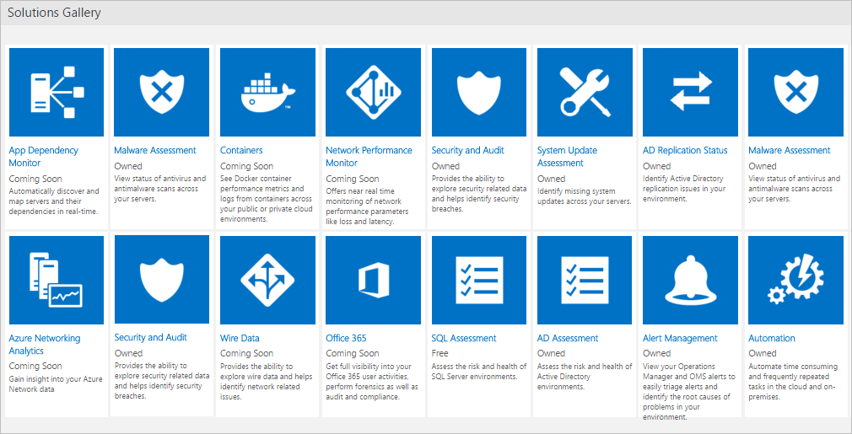
Solutions

Slide 11
Log Analytics HTTP Data Collector API
This API enables you to send custom data directly to our Log Analytics endpoint via HTTP.
https://blogs.technet.microsoft.com/msoms/2016/08/30/http-data-collector-api-send-us-data-from-space-or-anywhere/
https://azure.microsoft.com/en-us/documentation/articles/log-analytics-data-collector-api/

Slide 12
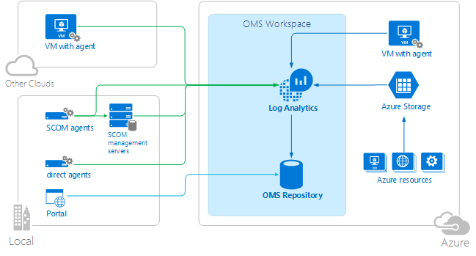
Log Analytics Architecture

Slide 13
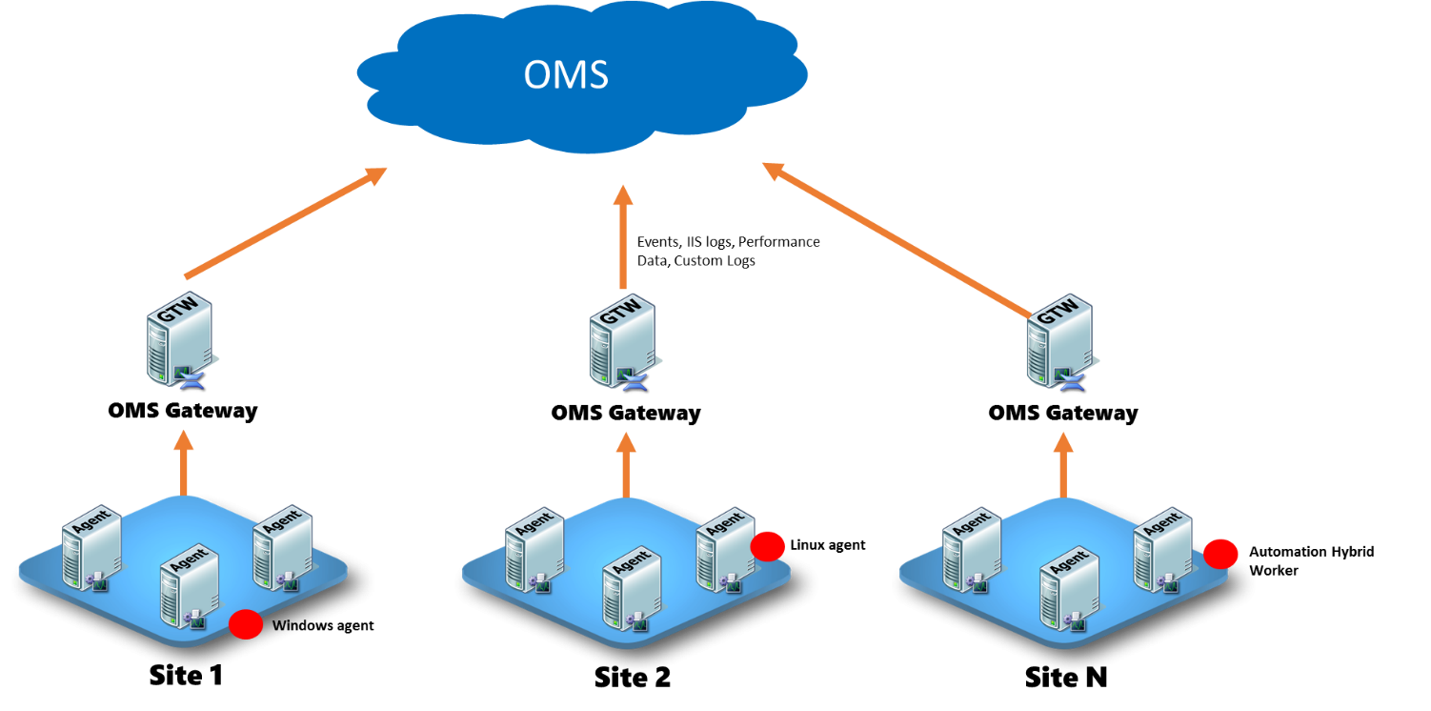
OMS Log Analytics Forwarder
https://blogs.technet.microsoft.com/msoms/2016/03/17/oms-log-analytics-forwarder/

Slide 14
Lab Overview

Slide 15

OMS Lab Environment
Contoso.com
lx-centos
spfarm-ad
Direct Agent
OMS – Log Analytics
spfarm-sp
spfarm-sql

Slide 16
Lab Outline
Azure Account
Deploy VMs
OMS onboarding
Azure Automation
Solution
Log Analytics
Security and Compliance
Azure Backup

Slide 17
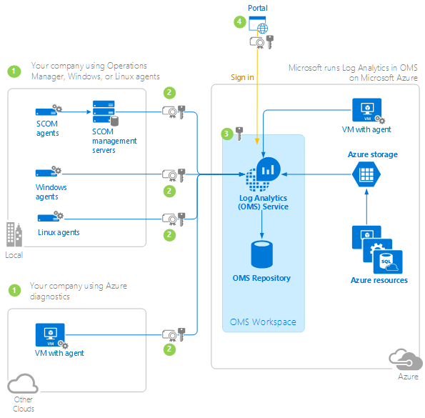
Security https://azure.microsoft.com/nl-nl/documentation/articles/log-analytics-security/

Slide 18
Purchasing the Operations Management Suite
Pay-as-you-go
(Can use monetary commit)
Suites – requires annual pre-commitment
(Cannot use monetary commit)
Service | Price (per month)
Insight & Analytics (includes Log Analytics) | $15/ node
Automation & Control | $10/ node
Security & Compliance or Azure Security Center | $15/ node
Backup | $10/ node
Site Recovery – E2E | $16/ node
Site Recovery – E2A | $25/ node
Log Analytics | $2.3 per GB
Automation | $0.002 per min
Suite | Price (per month)
Insight & Analytics suite Insight & Analytics SCOM | $15/ node
Automation & Control suite Automation & Control SCCM & Orchestrator | $10/ node
Security & Compliance suite Azure Security Center or OMS Security & Compliance | $15/ node
Protection & Recovery suite Backup Site Recovery – E2E & E2A VMM & DPM | $30/ node
Suite | Price (per month)
OMS E1 Insight & Analytics Automation & Control All of System Center | $20/ node
OMS E2 Insight & Analytics Automation & Control Security & Compliance Backup Site Recovery – E2E & E2A All of System Center | $35/ node
Any data charges associated with Backup and Site Recovery are charged separately at regular Azure storage rates
Data ingested for all other services in OMS include 1 month of retention at no additional charge. Retention of data for longer then a month is charged at $0.10/GB/month
http://oms-calculator-webapp.azurewebsites.net/home
http://download.microsoft.com/download/5/C/4/5C41780B-5821-4EB8-AA23-60404A224568/OMS_Pricing_and_Licensing_Datasheet.pdf
(All prices are monthly prices without any customer discounts)

Slide 19
Resources
OMS Product Team Blog
https://blogs.technet.microsoft.com/msoms/
Technical documentation
https://azure.microsoft.com/en-us/documentation/services/log-analytics/

